Slide 1


RAILWAY AND BUS BOOKING SYSTEM
DEPLOYMENT OF WEB-APPLICATION IN AWS CLOUD SERVICE

Slide 2


Developed By
B.Praveen 19BCE7421
VSVM Praneeth 19BCE7449
Anoohya N 19BCE7530
Hemant K Rathore 19BCE7472

Slide 3
RAILWAY AND BUS BOOKING SYSTEM
A web application (Ticket) which helps the users to book tickets to be travelled either in Train or Bus. This web applications takes the details of the users to book the tickets as per their needs.
So the users are first asked to register and Login then he/she can proceed booking of tickets to travel either in train or buss as per their convenience.
This Application helps to keep track of their Previous history of booking Details and also it is helpful for multiple passengers booking under one user.

Slide 4
Deployment in Cloud
Used Cloud service AWS
Operating System Windows
RDC for access of GUI based AWS cloud Virtual machine

Slide 5
Pages in Web Application
index.php – Home page
register.php – to crate new account for user
sindex.php –to sign in
home.php – user account home (after login)
book.php – to book train ticket
bookbus.php –to book bus ticket
trainpay .php/buspay.php –to access payment details and pay the payment
busbookdone.php/trainbookdone.php –show the details of the bus and train and ticket details
trainschedule.php - user to check the train schedule

Slide 6
Used Services
Amazon Elastic Compute Cloud(EC2): It is a part of Amazon.com's cloud-computing platform, Amazon Web Services, that allows users to rent virtual computers on which to run their own computer applications.
Xampp: xampp server which is localhost to host the web application with a DB (Database) connectivity using various DB management languages and we used of mysql in this Xampp
RDC: RDC is used to connect to a remote desktop machine with a GUI interface, in our case it's used to connect to the AWS Cloud based Virtual Machine which is used to host our Website.

Slide 7
Configuration , Connectivity, DB instances
DB Name –train
Endpoint –https://us-west-2.console.aws.amazon.com/ec2/v2/home?region=us-west-2#InstanceDetails:instanceId=i-03bb17b908a5dc00c
Publicly Accessible – Yes
Instance Name –Ticket Booking

Slide 8
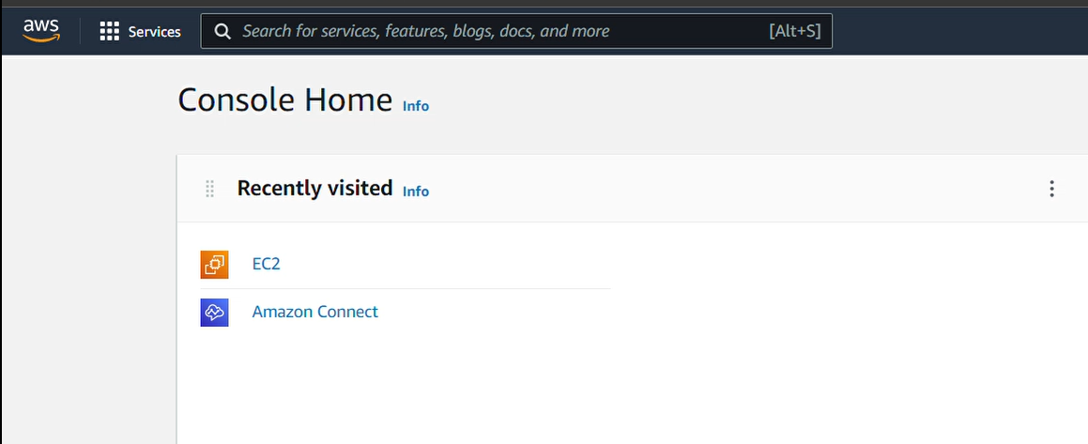
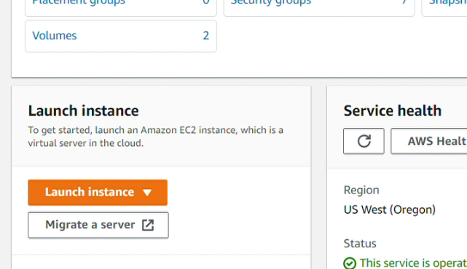
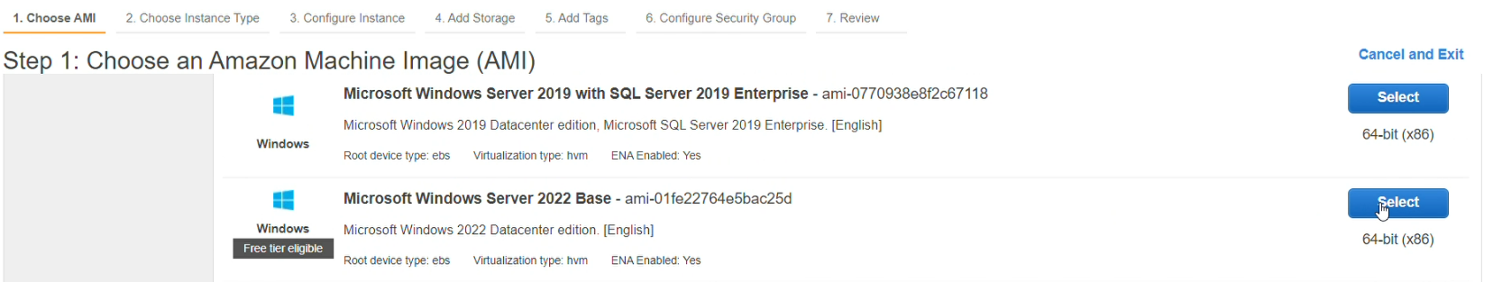
Creating Instance in AWS EC2

Slide 9
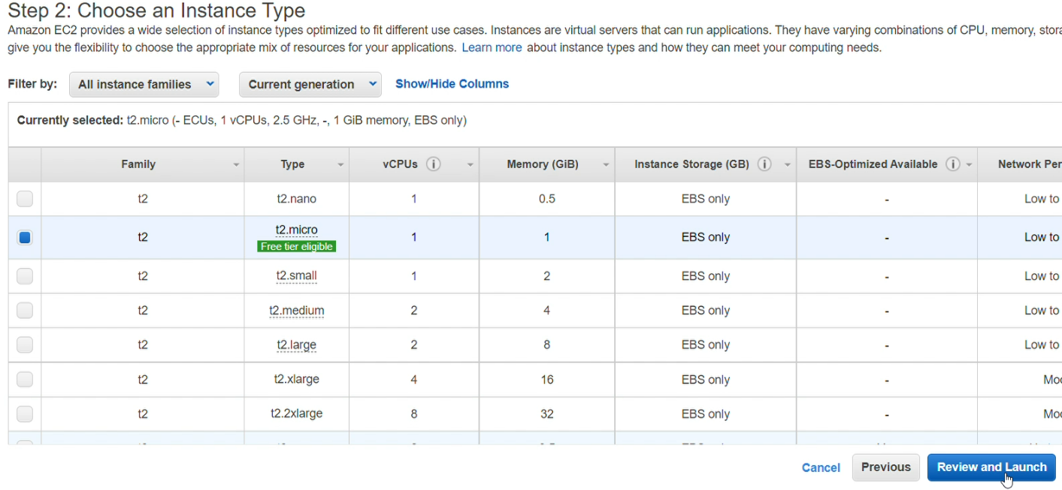
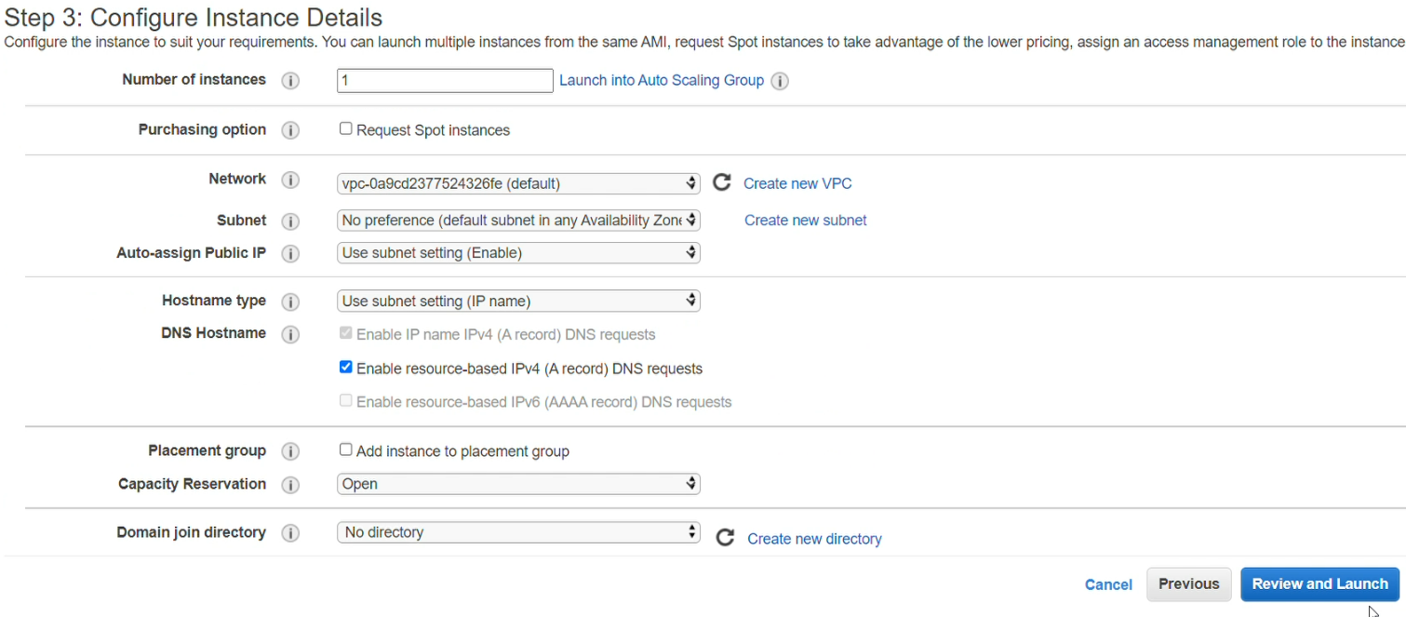
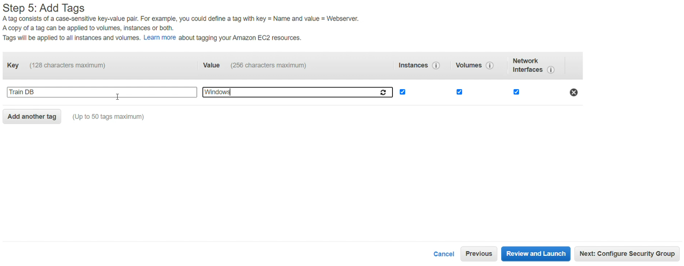

Slide 10
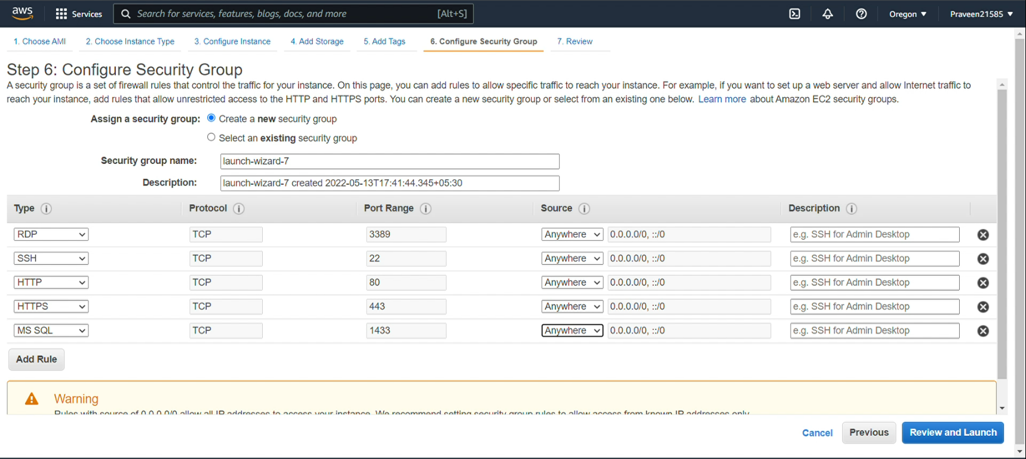

Slide 11
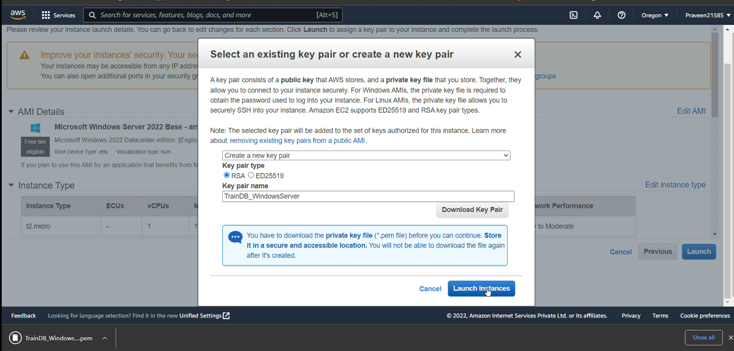

Slide 12
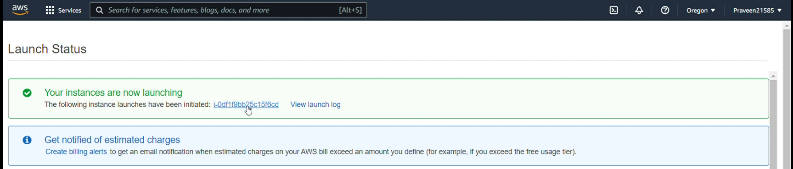
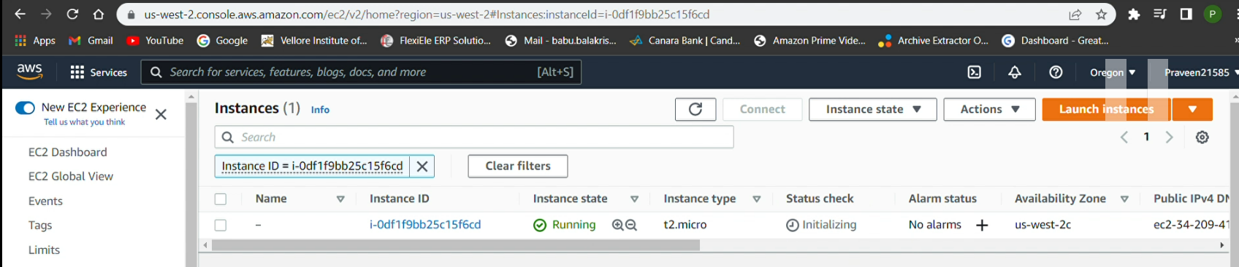

Slide 13
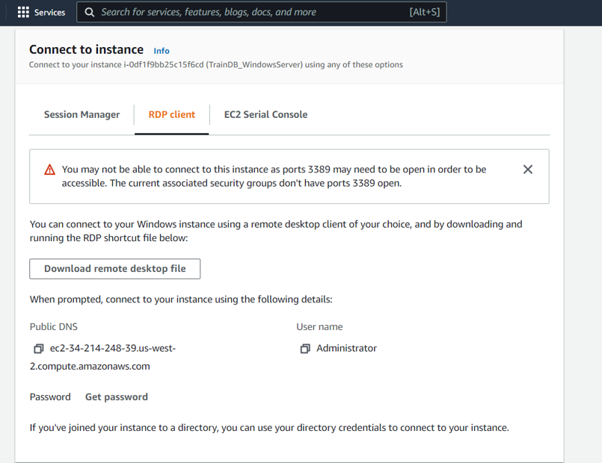
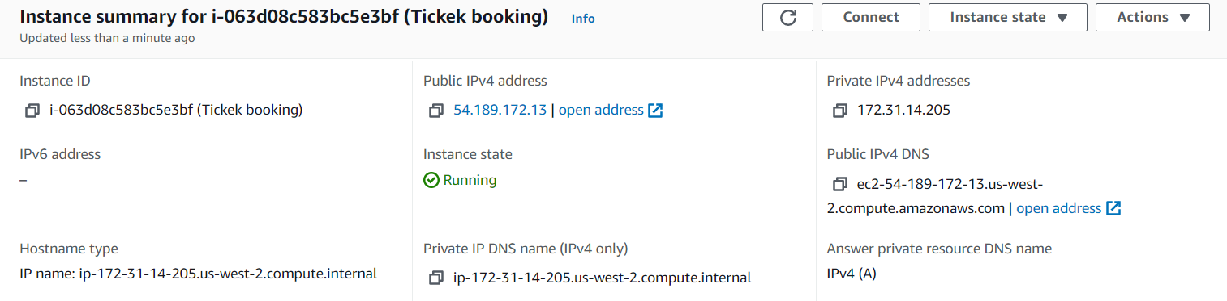





Slide 14
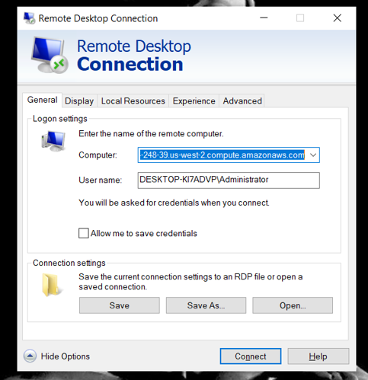
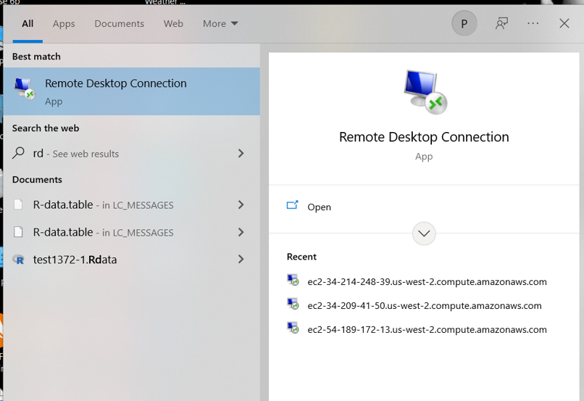


Slide 15
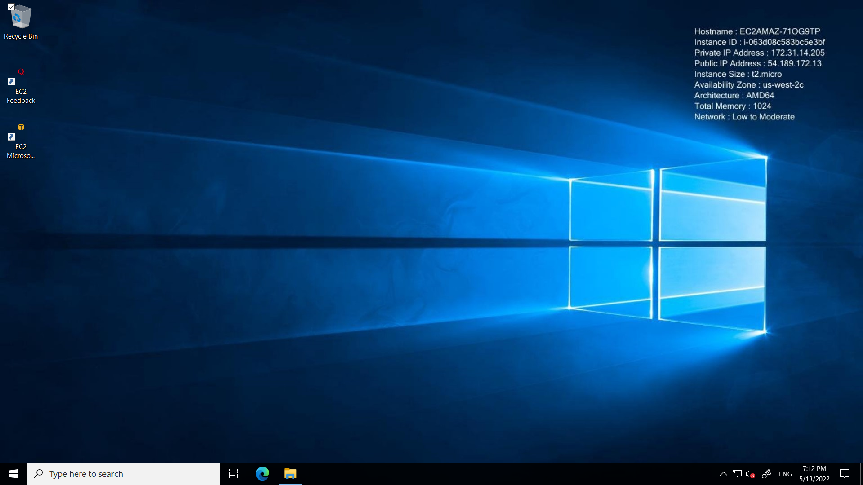
Window of RDP

Slide 16
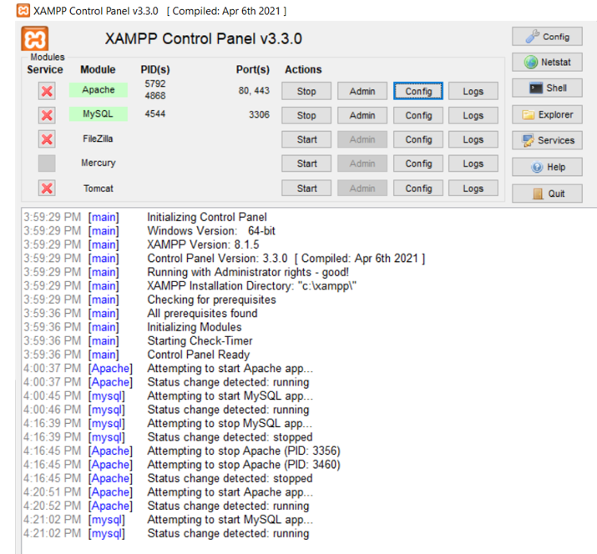
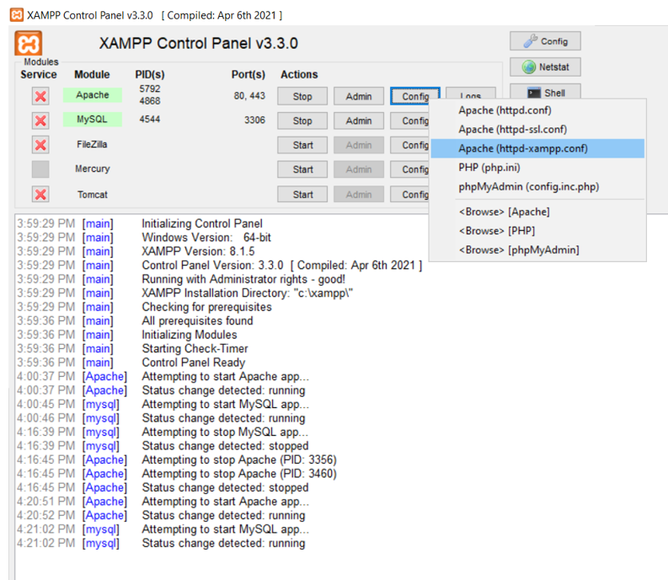
Installation of Xampp In RDP

Slide 17
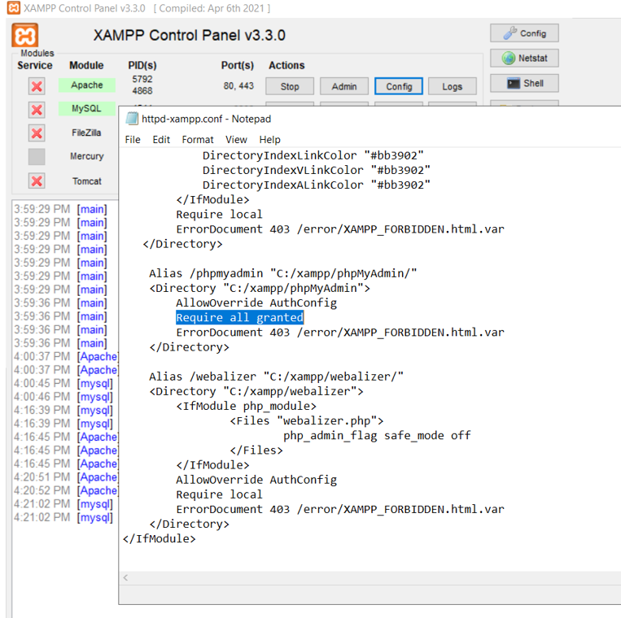
Configuration of Apache
“Required all granted ” helps to manually connect db in local machine instead of RDC to deploy the table in Xampp server where we are make useable in both interface.

Slide 18
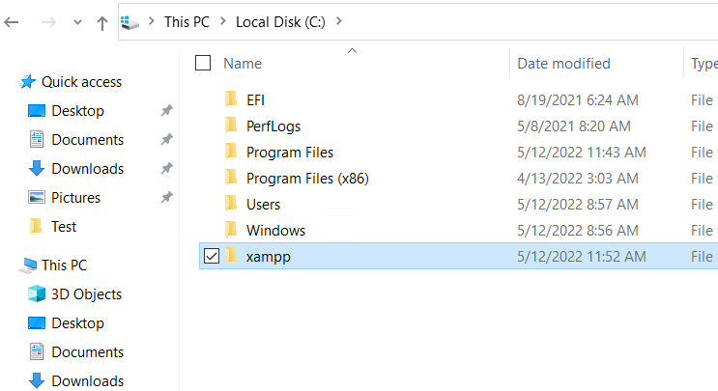
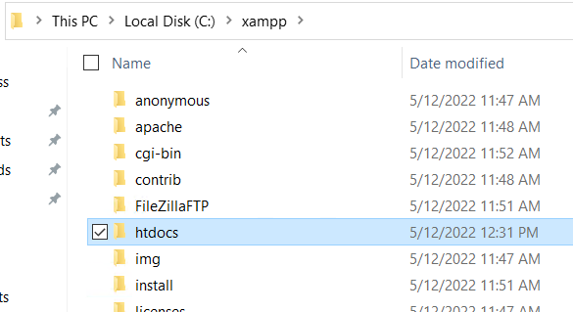
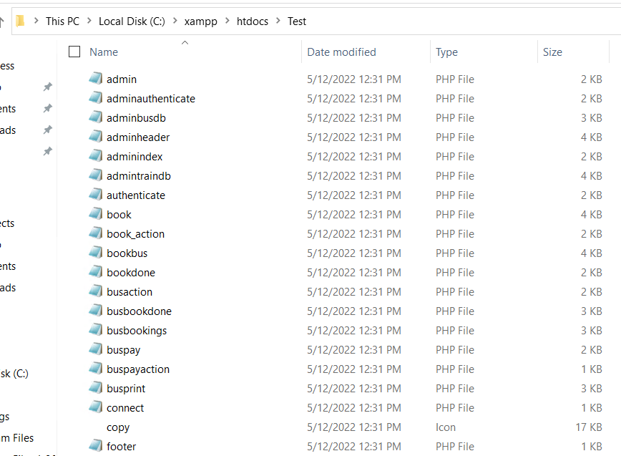
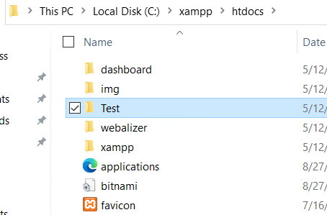
Loading of files

Slide 19
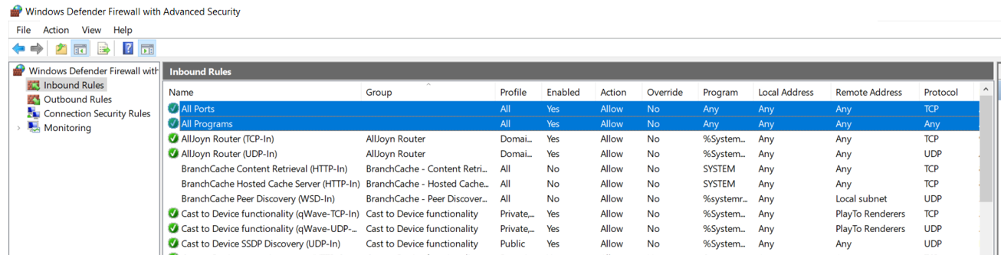
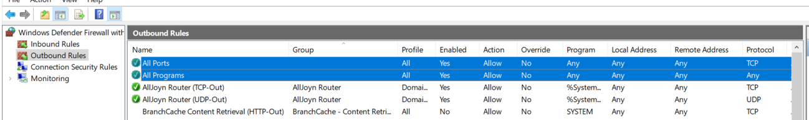
Firewall setting in RDC
Enabling access of All ports and All programs to deploy the web application in both Inbound Rules and Outboud Rules

Slide 20
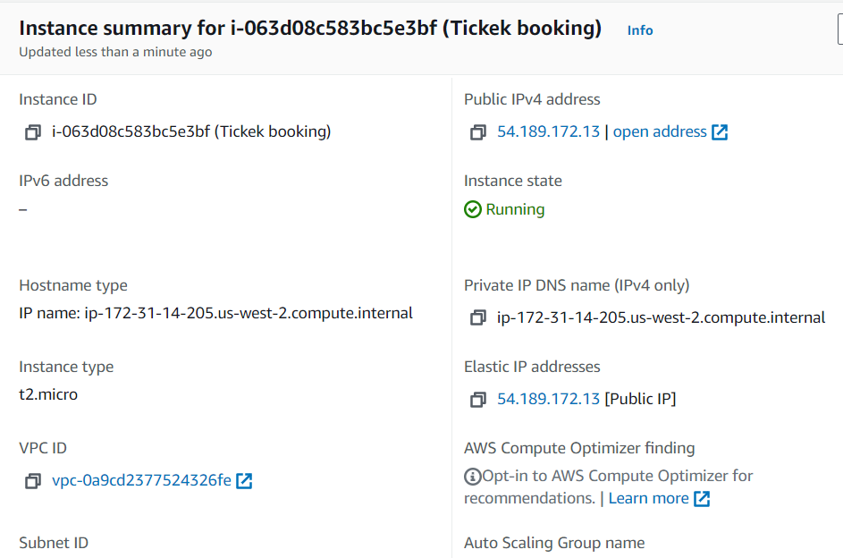
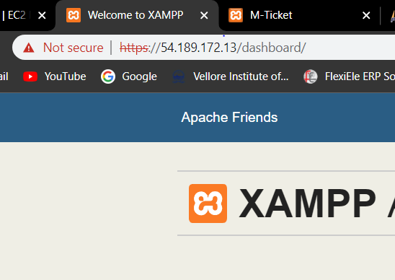

Back to EC2 in Local Machine

Slide 21
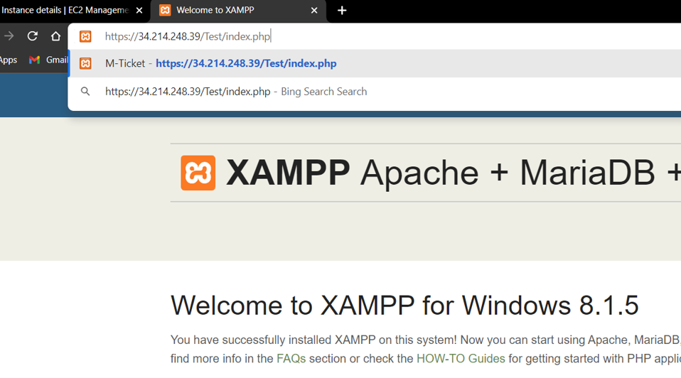
Opening Home page and phpMyAdmin of Web Application

Slide 22
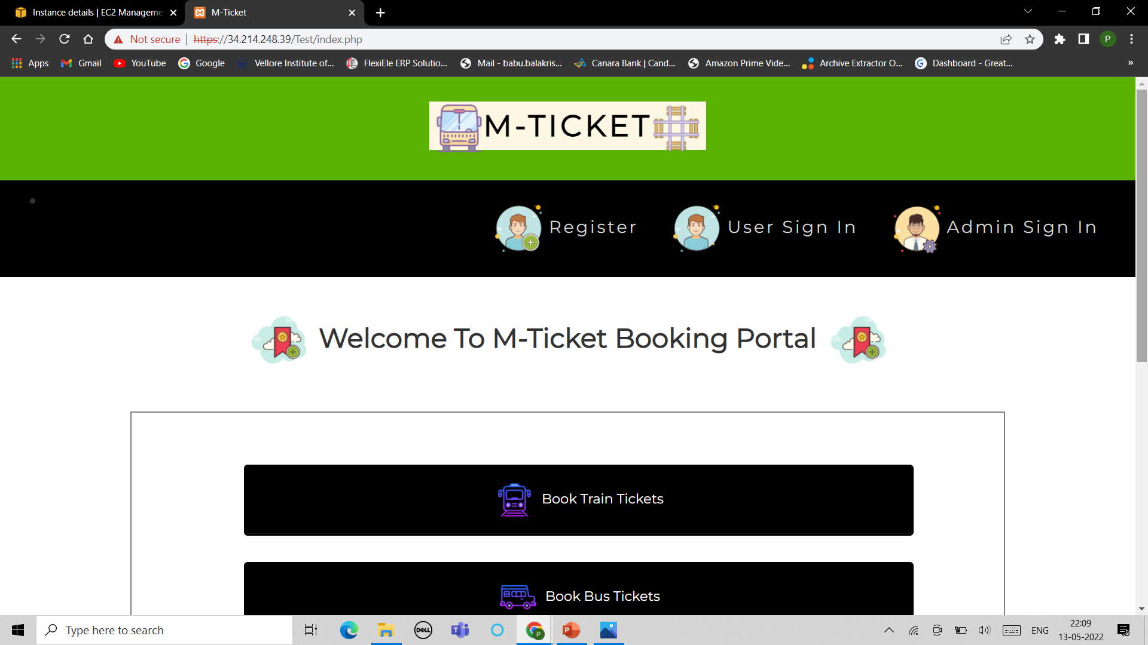
Home Page of the Application

Slide 23
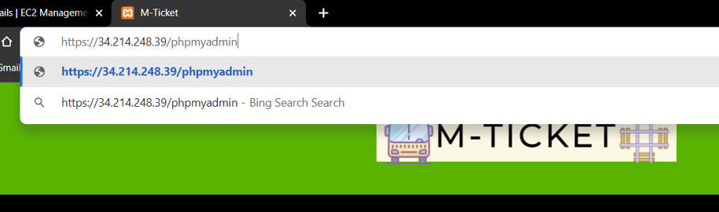
Accessing phpMyAdmin page

Slide 24
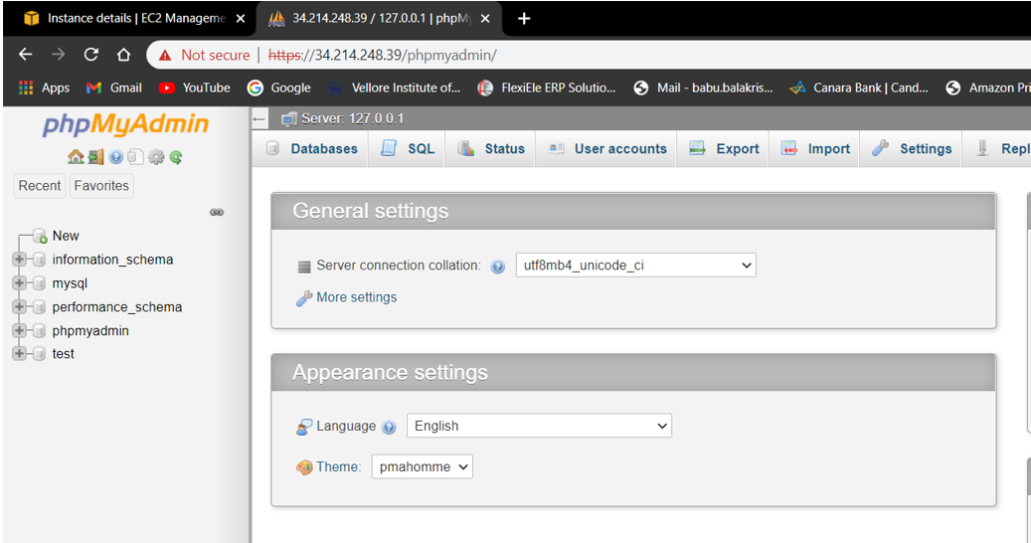

phpMyAdmin Page

Slide 25
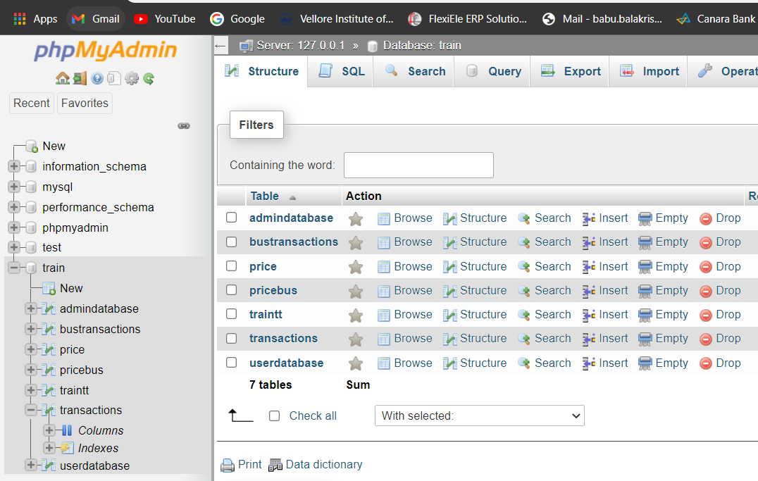
ADDING Database and Tables

Slide 26
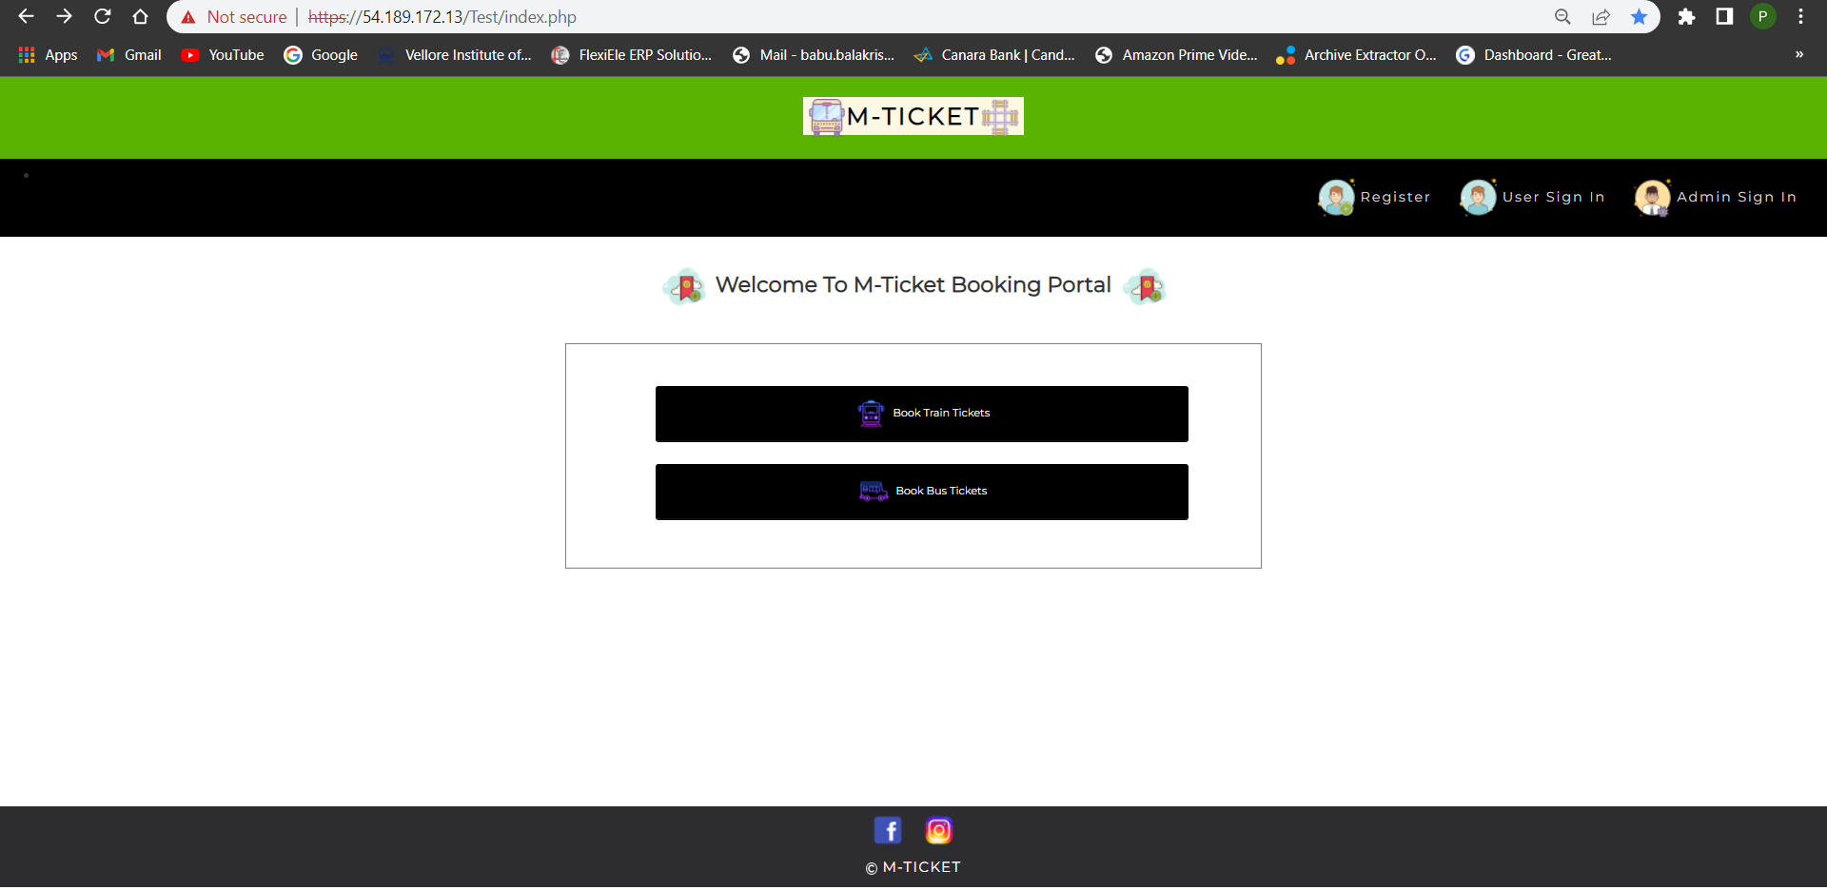
Web Application Work

Slide 27
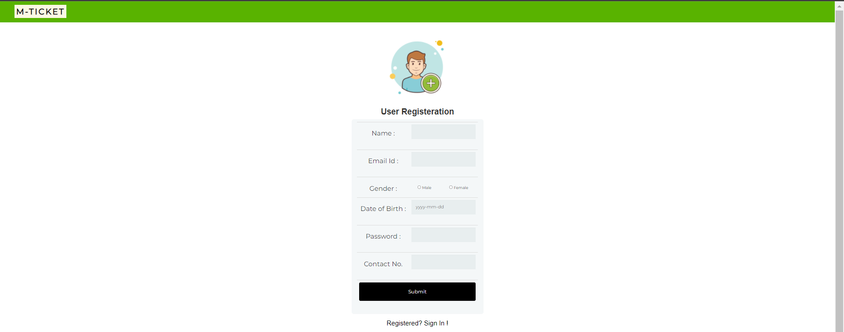
USER REGISTRATION PAGE

Slide 28
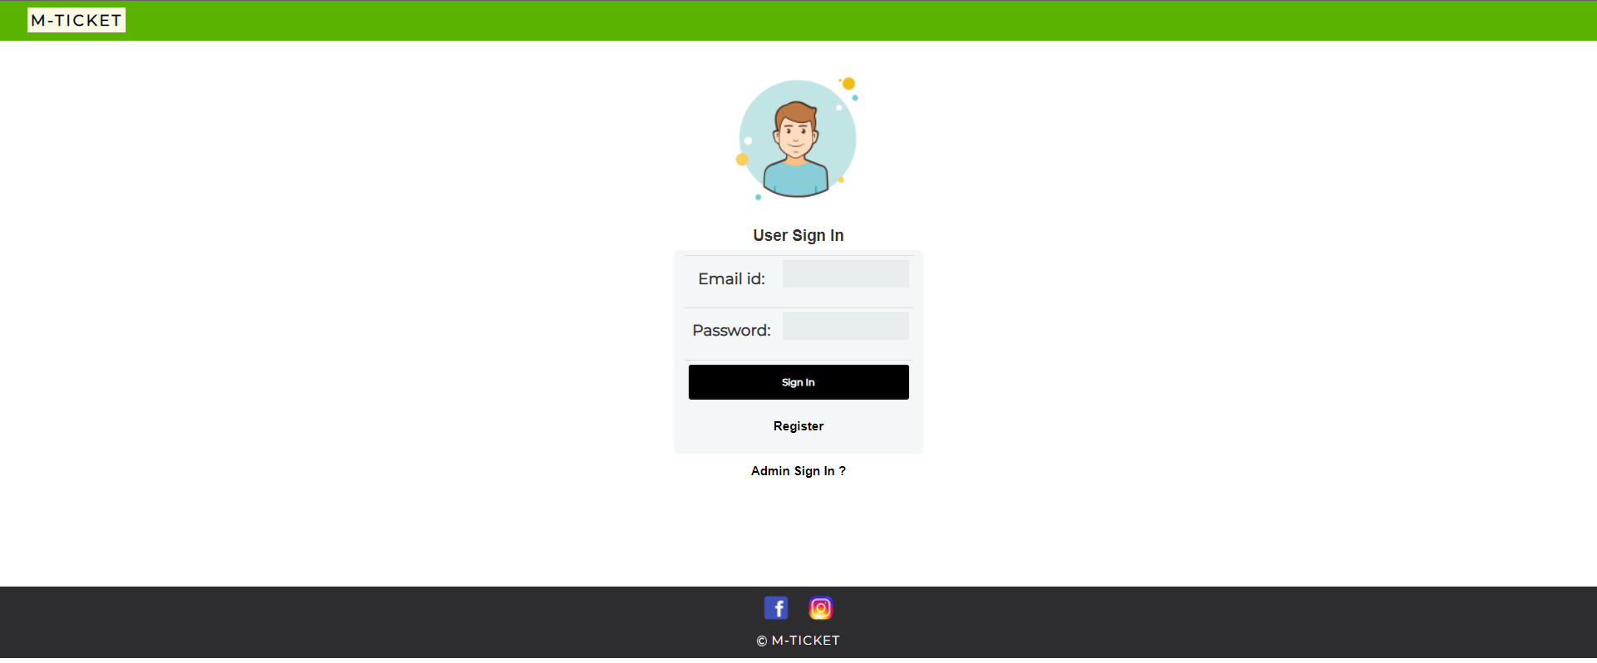
Sign In Page

Slide 29
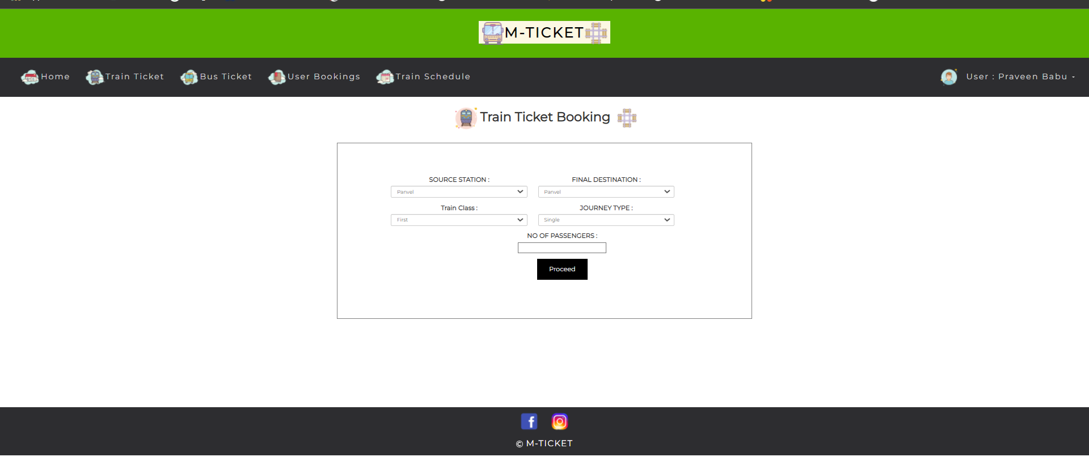
Train Booking Page

Slide 30
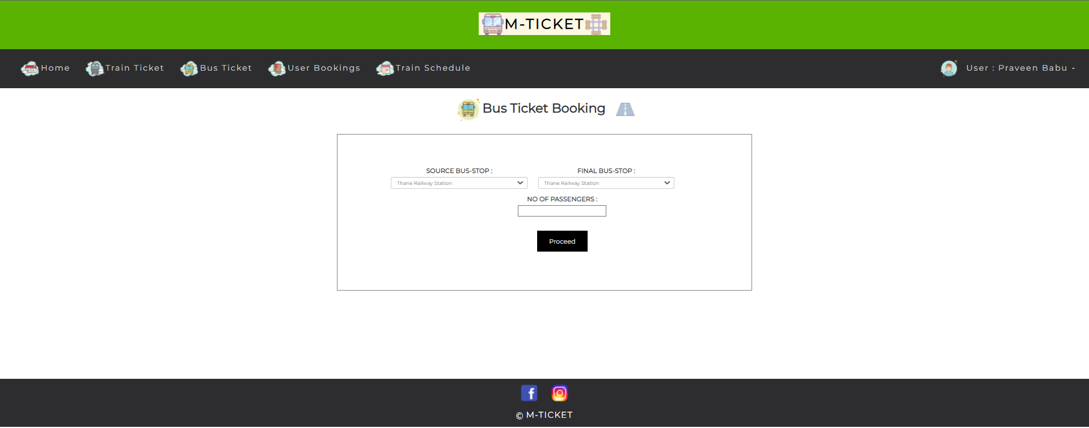
Bus Booking Page

Slide 31
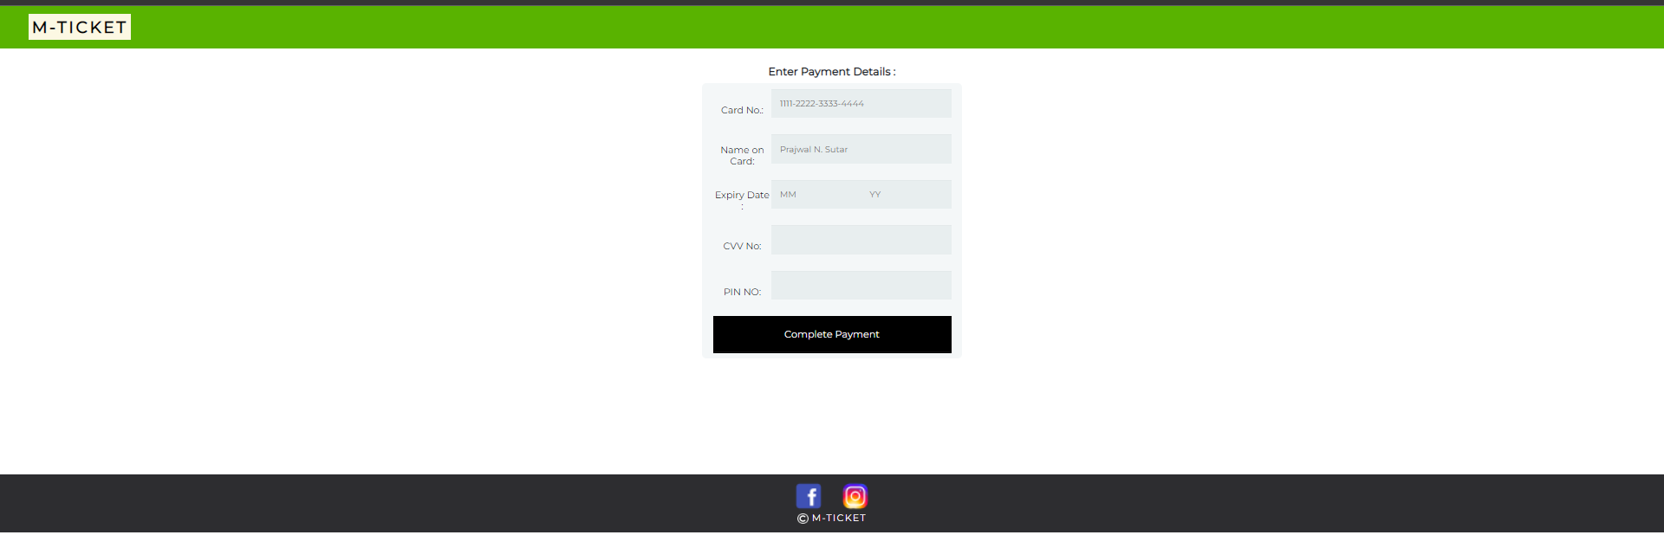
Payment Page

Slide 32
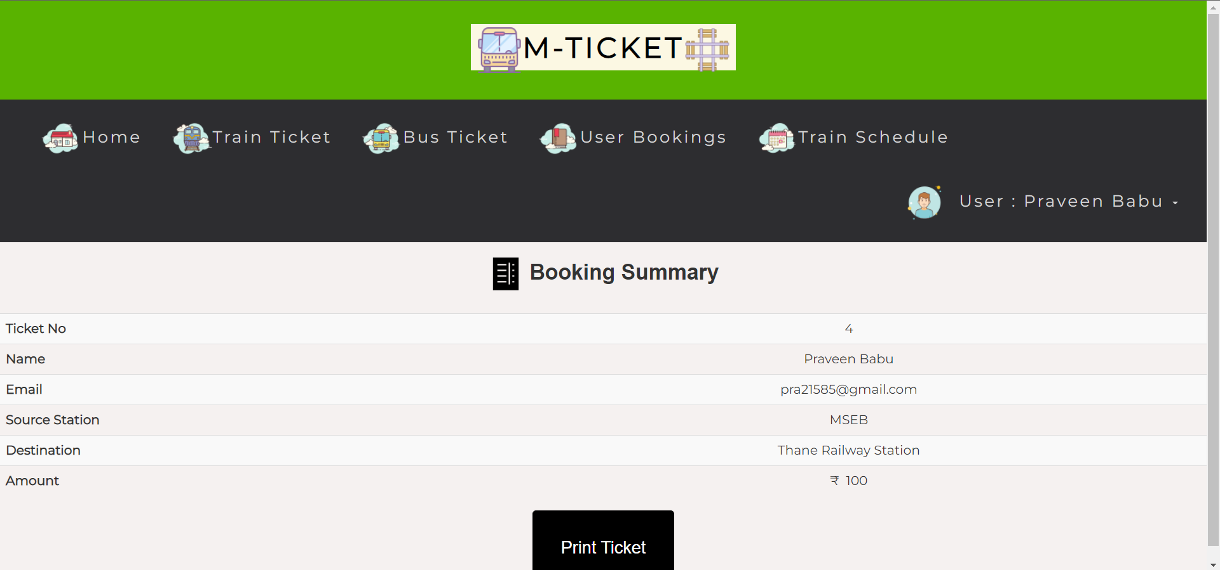
Displaying Ticket Deatils

Slide 33
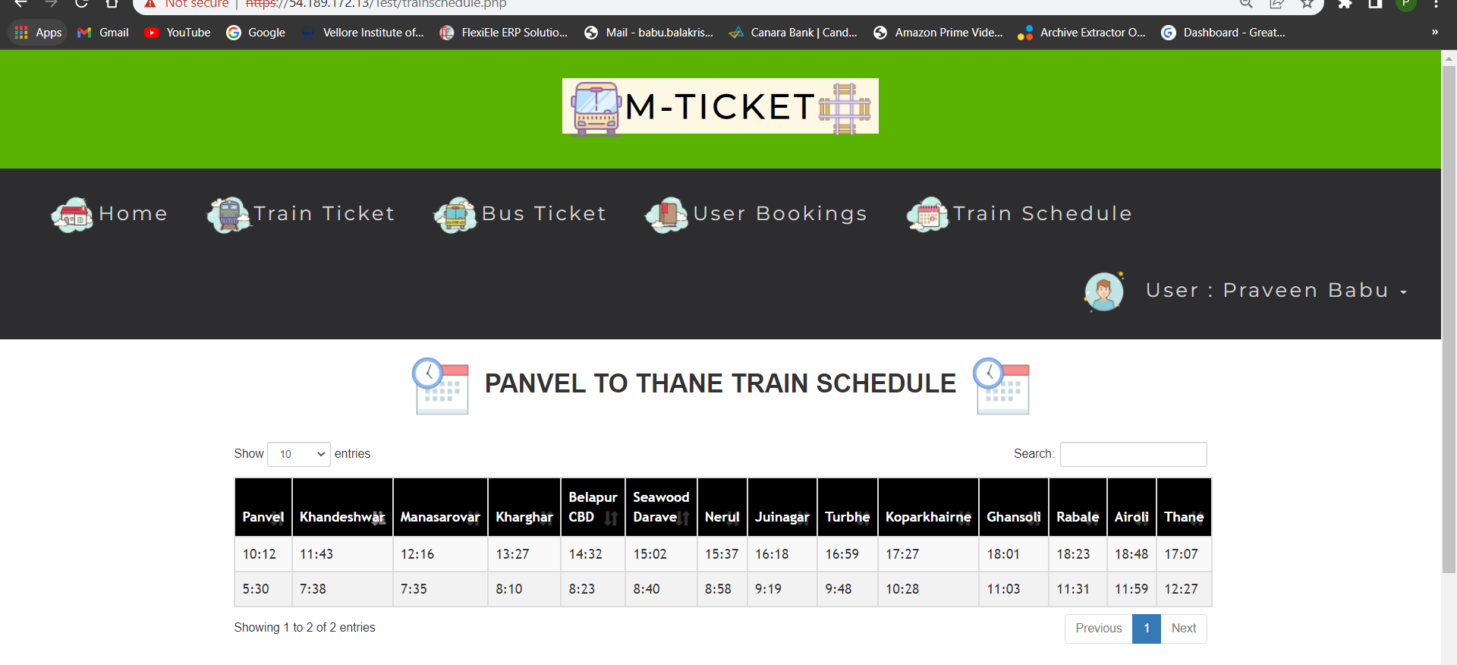
Train Schedule

Slide 34
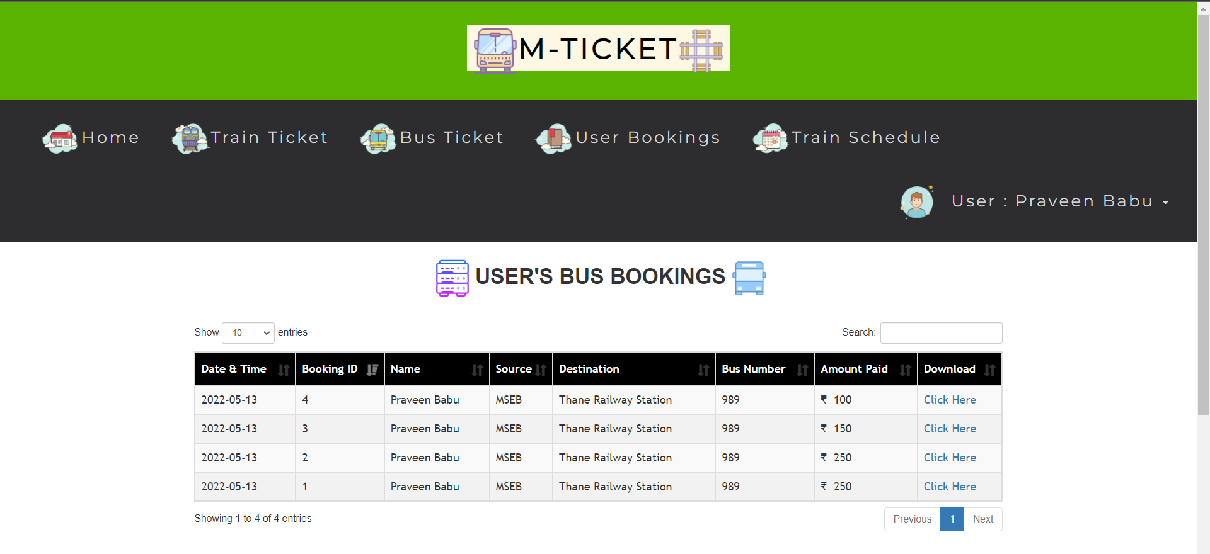
Display of User Booking

Slide 35
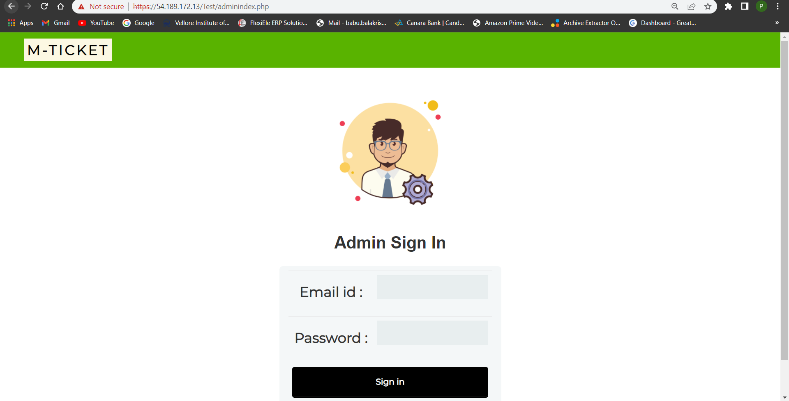
Admin Login

Slide 36
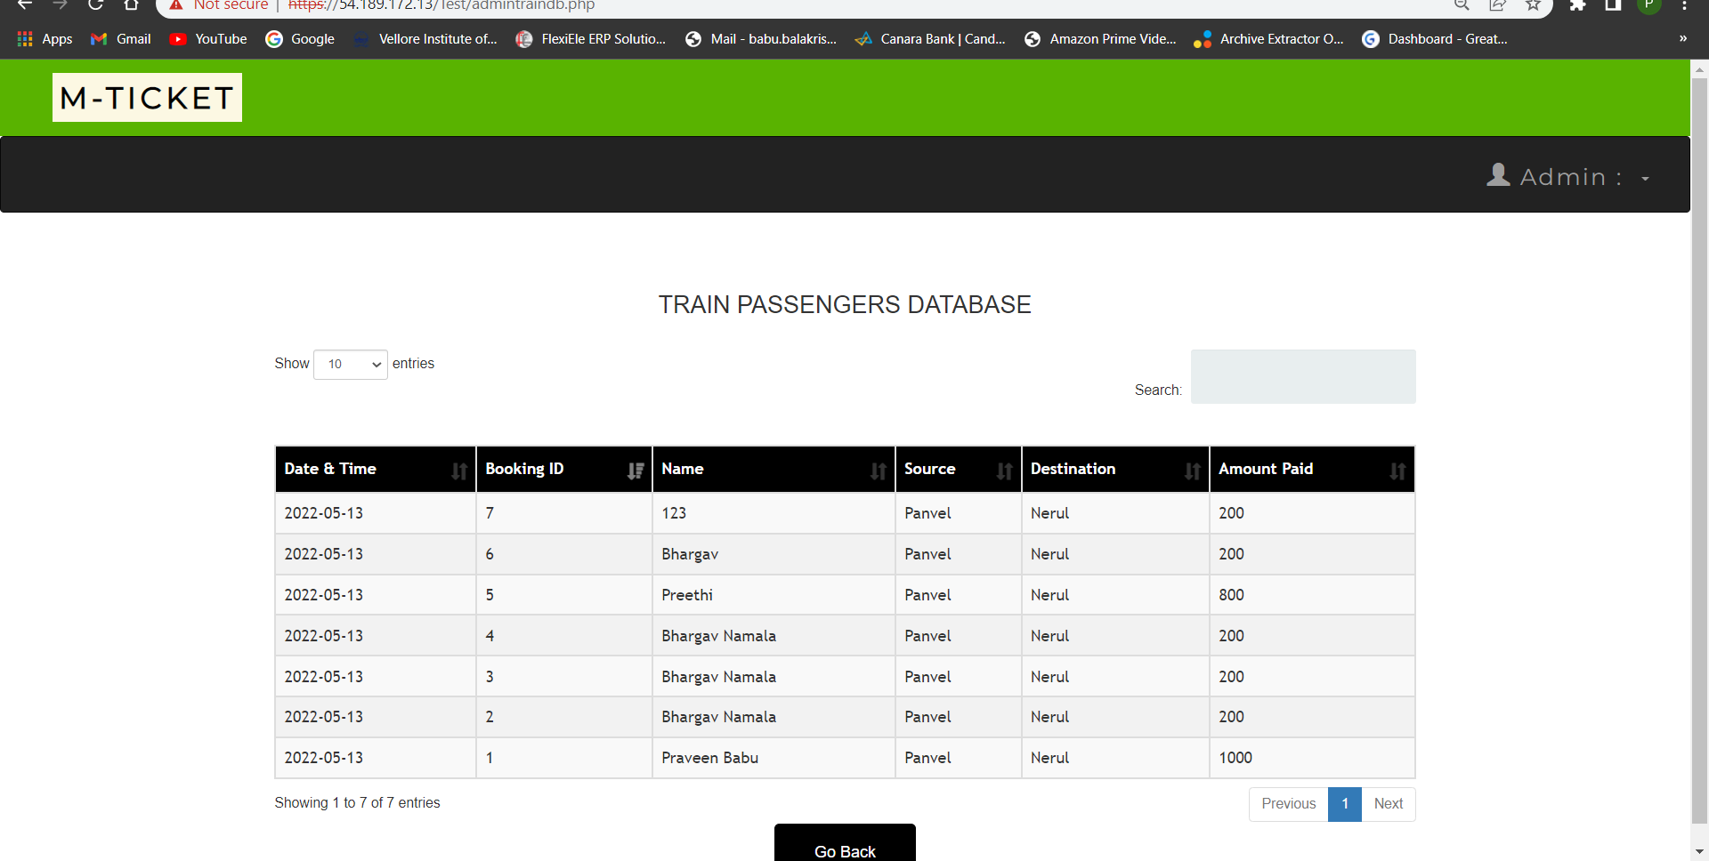
Admin Access To data

Slide 37
Conclusion
We were able to host our Court Booking web application using Amazon EC2, RDS and Route 53 and were able to access the application from an external PC connected to Internet.

Slide 38
THANK YOU

